Slide 1
Simulations Part 2

Slide 2
Side Note
w<-c(TRUE, TRUE, FALSE)
w output:
class(w) output:
as.numeric(w) output:
Conclusion: Changing the class of a logical vector into a numeric vector, changes the TRUE for 1 and the FALSE for 0.

Slide 3
Types of Probabilities
Theoretical Probabilities
Experimental Probabilities

Slide 4
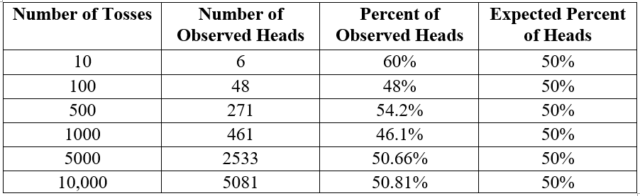
Law of Large Numbers
Law of Large Numbers: In the long run, as the number of trials increases and increases, the proportion of the outcomes get closer to the theoretical probability values.

Slide 5
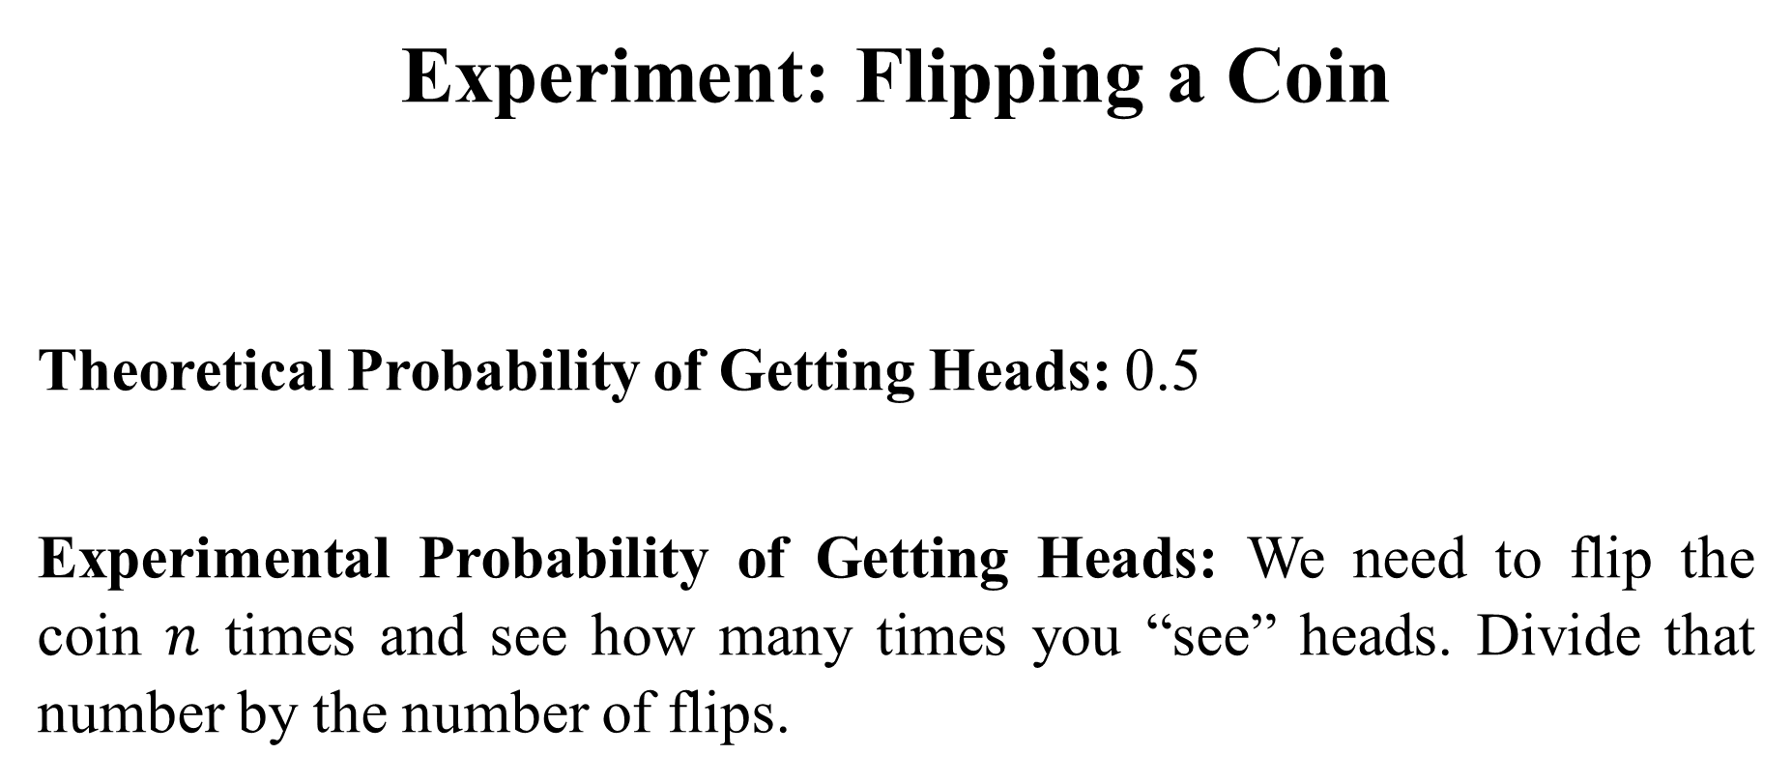
Experiment: Flipping a Coin
Theoretical Probability of Getting Heads: 0.5
Experimental Probability of Getting Heads: We need to flip the coin $n$ times and see how many times you “see” heads. Divide that number by the number of flips.

Slide 6
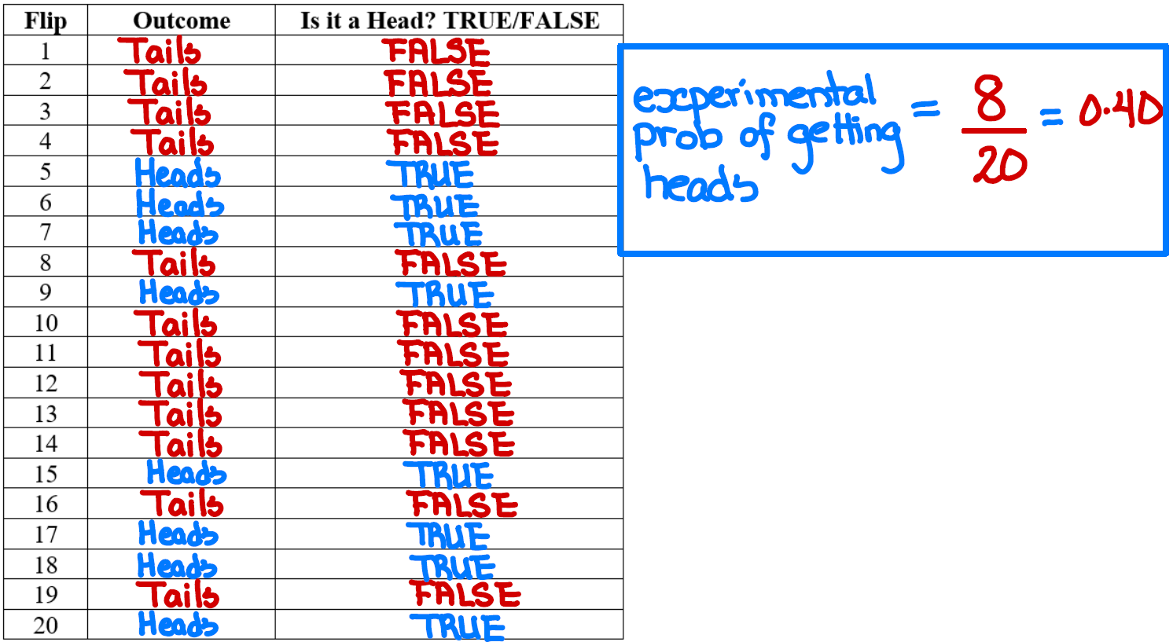

Slide 7
Simulations
Step 1: Simulate One Trial (One Flip)
coin_flip <- sample(c("H", "T"), 1)

Slide 8
Step 2: Check the criteria that you are trying to compute the probability on.
Checking if that flip is "Heads" (because that is the one that you wanted to compute the probability on)
check_flip <- coin_flip == "H"

Slide 9
Step 3: Create a Function that performs 1 Trial and checks if it met the criteria.
In our example, the function will flip the coin once and checks if it is Heads
coin_function <- function(i) {
coin_flip <- sample(c("H", "T"), 1)
check_flip <- coin_flip == "H"
return(check_flip)
}

Slide 10
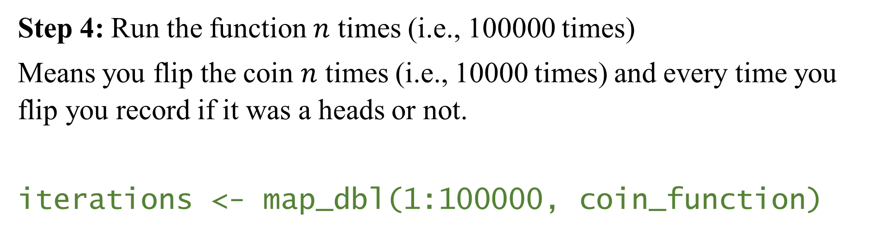
Step 4: Run the function $n$ times (i.e., 100000 times)
Means you flip the coin $n$ times (i.e., 10000 times) and every time you flip you record if it was a heads or not.
iterations <- map_dbl(1:100000, coin_function)

Slide 11
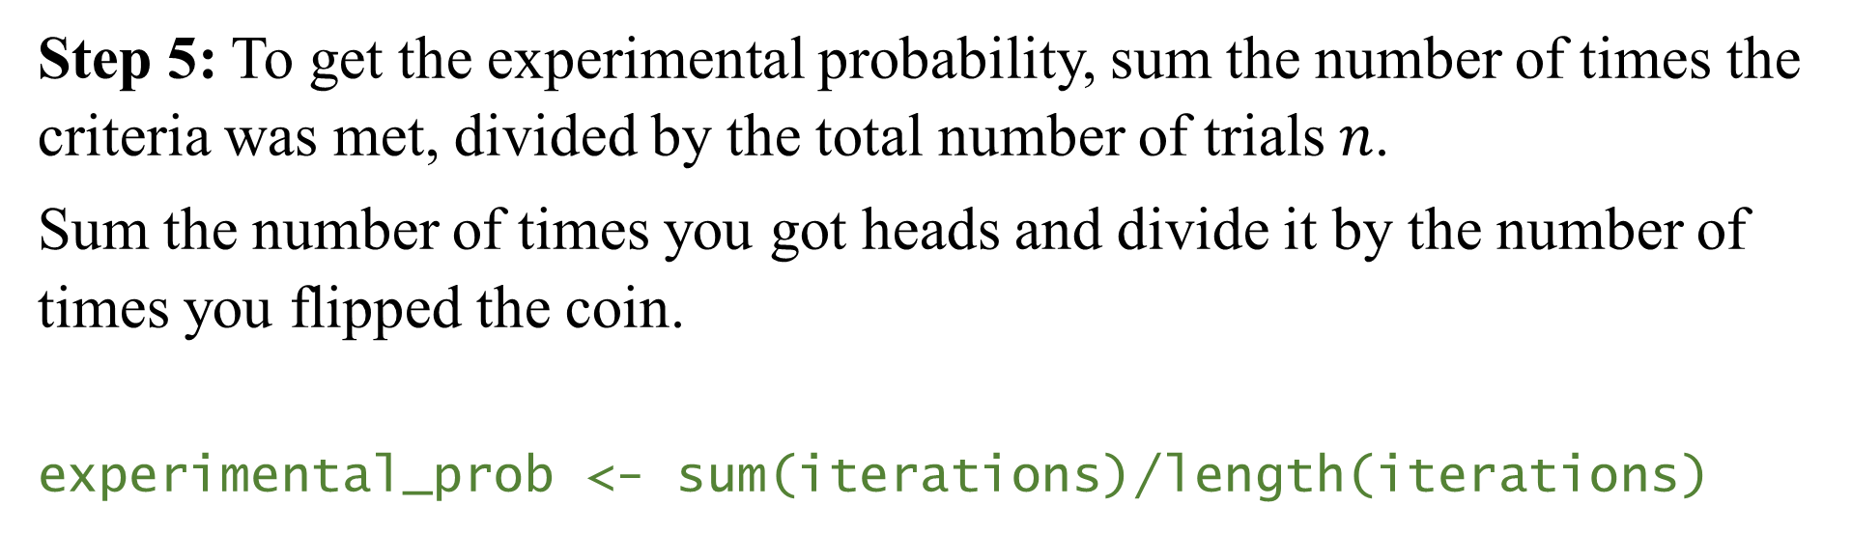
Step 5: To get the experimental probability, sum the number of times the criteria was met, divided by the total number of trials $n$.
Sum the number of times you got heads and divide it by the number of times you flipped the coin.
experimental_prob <- sum(iterations)/length(iterations)

Slide 12
Step 6: Theoretical probability
theoretical_prob <- 1/2
Step 7: Theoretical probablity vs experimental
theoretical_prob - experimental_prob

Slide 13
Full Codes
coin_function <- function(i) {
coin_flip <- sample(c("H", "T"), 1)
check_flip <- coin_flip == "H"
return(check_flip)
}
iterations <- map_dbl(1:100000, coin_function)
experimental_prob <- sum(iterations)/length(iterations)
theoretical_prob <- 1/2
theoretical_prob - experimental_prob

